Slide 1
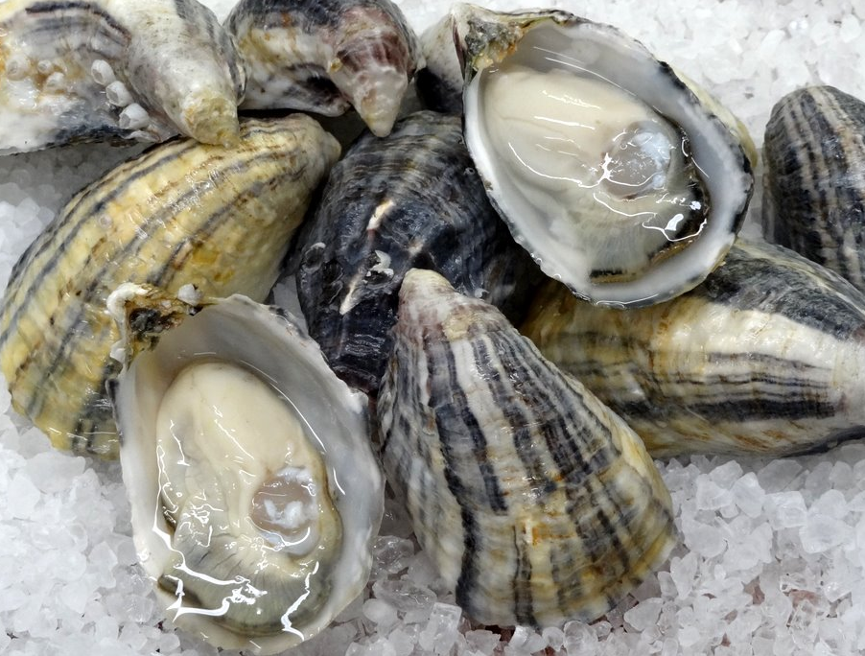

Exploring Proteomic Variation in Pacific Oysters
Yaamini Venkataraman
University of Washington, Seattle
@YaaminiV
Photo from Willapa Oysters
Notes:
Today I’m going to talk about our project exploring proteomic variation in Pacific oysters, really understanding how location affects protein expression, and why that’s important for thriving in changing environmental conditions.

Slide 2




Outline
Importance of Proteins
Outplant experiment
Proteomic resource
1
2
Acknowledgements:
Roberts Lab
Micah Horwith
Alex Lowe
Emma Timmins-Schiffman
1
2
3
4
3
4
Notes:
I’ll first highlight the importance of proteins for understanding how organisms like Pacific oysters respond to changing environmental conditions. I’ll then go into our outplant experiment and show you results from the proteomic resource we developed. Before I begin, I’d like to acknowledge the Roberts Lab at UW SAFS, Micah Horwith at the Department of Natural Resources, Alex Lowe at UW Biology, and Emma Timmins-Schiffman at the UW Department of Genome Sciences for their assistance with this work.

Slide 3
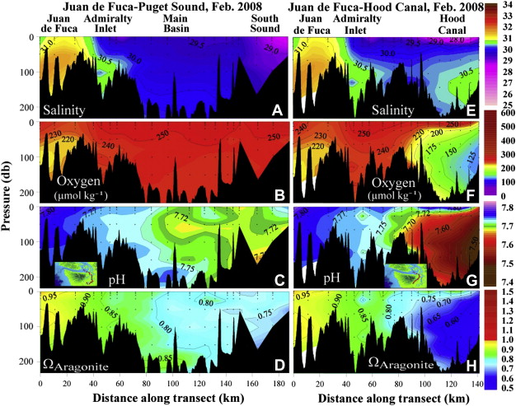
Puget Sound is Changing
Variable conditions
Proteins: direct connection to environmental response
Success in previous studies (Timmins-Schiffman 2014)
Feely et al. 2010
Notes:
Four hours into this session, we’ve established that Puget Sound is changing. It’s already above-acidic waters have surface pCO2 levels vary spatially and temporally, and subsurface water in many parts of Puget Sound are undersaturated with aragonite (blue ribbon panel). We’re aware that location is an important driver in understanding water chemistry. In this figure from Feely et al. 2010, environmental variables such as salinity, oxygen, pH and aragonite vary depending on where you are in the sound. As much as we know about the conditions of Puget Sound and how species react in general, we don’t know how these changes will affect shellfish like the Pacific oyster at specific locations. Which is where proteomics and studyng protein expession come in. Proteins provide a direct connection to an oyster’s stress response and they can give us insight into change that are harder to see. Previous studies have used proteomics to understand how larval and adult Pacific oysters respond to ocean acidification. Using these techniques, we can piece together how location in the sound affects Pacific oysters.

Slide 4
How does environmental variability affect C. gigas’ physiological response?
Notes:
More specifically: How does environmental variability affect the Pacific oyster’s physiological response to ocean conditions?

Slide 5
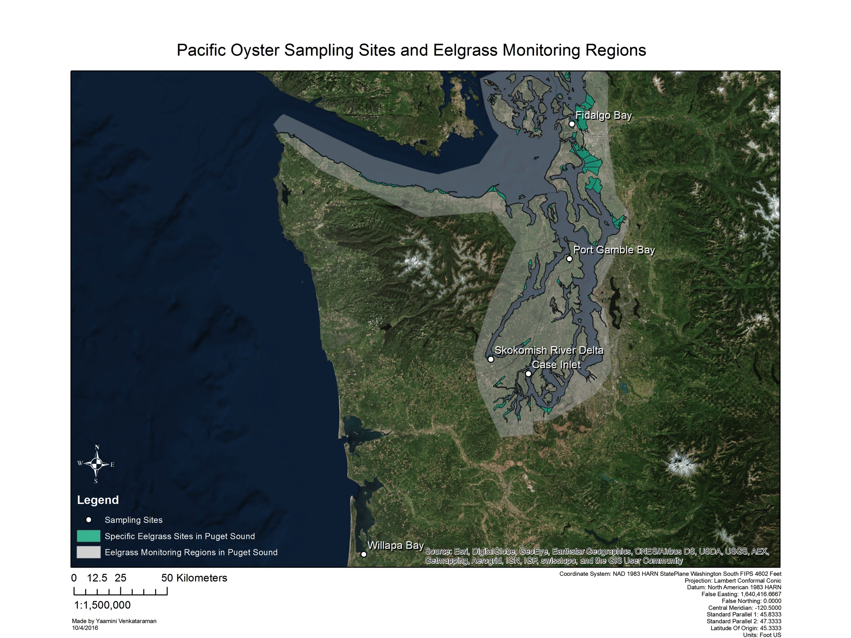
Outplant Experiment
150 sibling oysters outplanted June 2016
5 sample sites
Fidalgo Bay (FB)
Port Gamble Bay (PG)
Skokomish River Delta (SK)
Case Inlet (CI)
Willapa Bay (WB)
Differences in pH, DO, temperature measured
Notes:
The Department of Natural Resources outplanted 150 sibling Pacific oysters in June 2016 at five different locations in and around Puget Sound: Fidalgo bay, Port Gamble Bay, Skokomish River Delta, Case Inlet and Willapa Bay. At each of these locations, oysters were placed in both eelgrass and bare sites to see if eelgrass presence had any effect on protein expression. Continuous pH, dissolved oxygen and temperature measurements were taken for the month-long duration of the outplant. So we established some site and habitat variability. How do we know if there were any differences in protein expression because of the environmental variables at these sites?

Slide 6
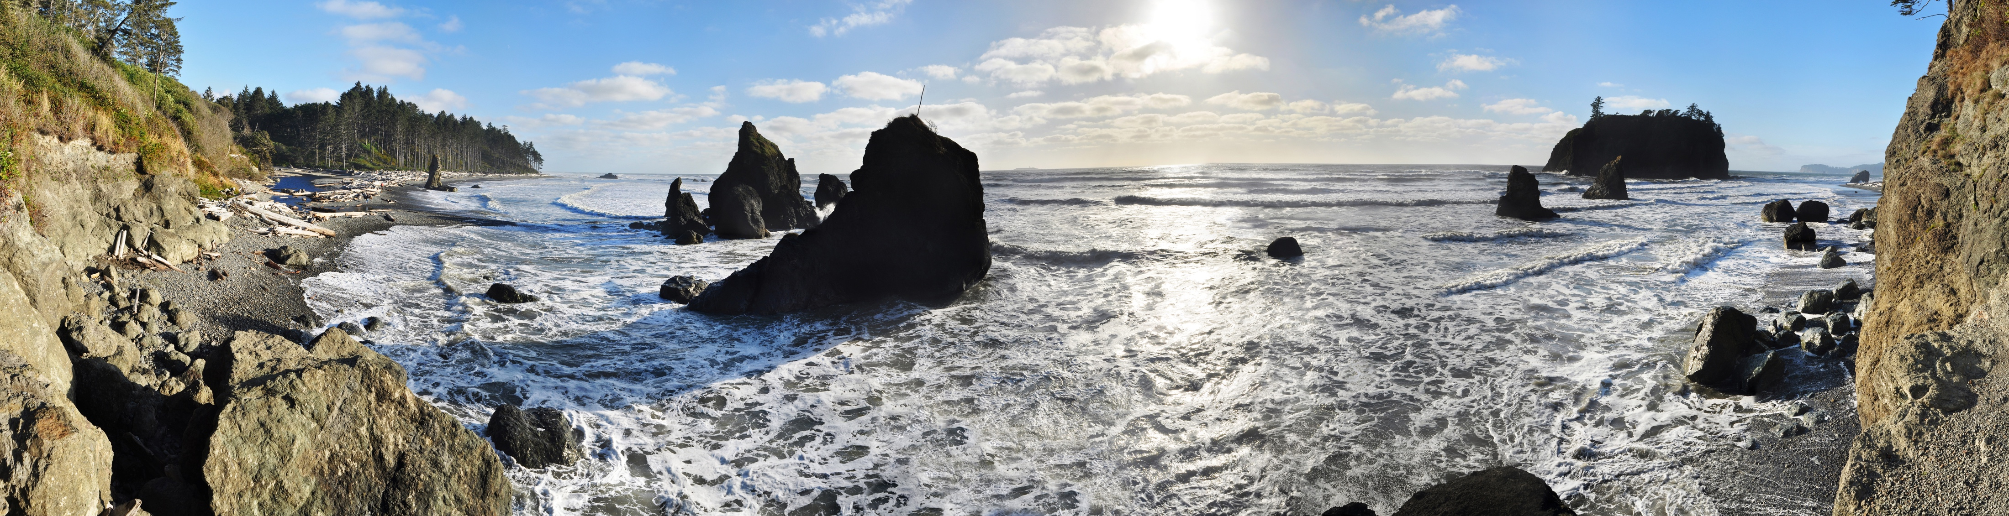
Mass Spectrometry
Shotgun Proteomics:
What proteins are there?
Selected Reaction Monitoring: What are we interested in?
Notes:
We can use two separate mass spectrometry methods: shotgun proteomics and selected reaction monitoring. Shotgun proteomics is a discovery phase. It allows us to answer the question: what proteins are there? It provides us with a panorama picture. We can then use our shotgun proteomics results to inform a second method, selected reaction monitoring. This method allows us to zoom in to what we're actually interested, like specific environmental response proteins and how their expression varies.

Slide 7
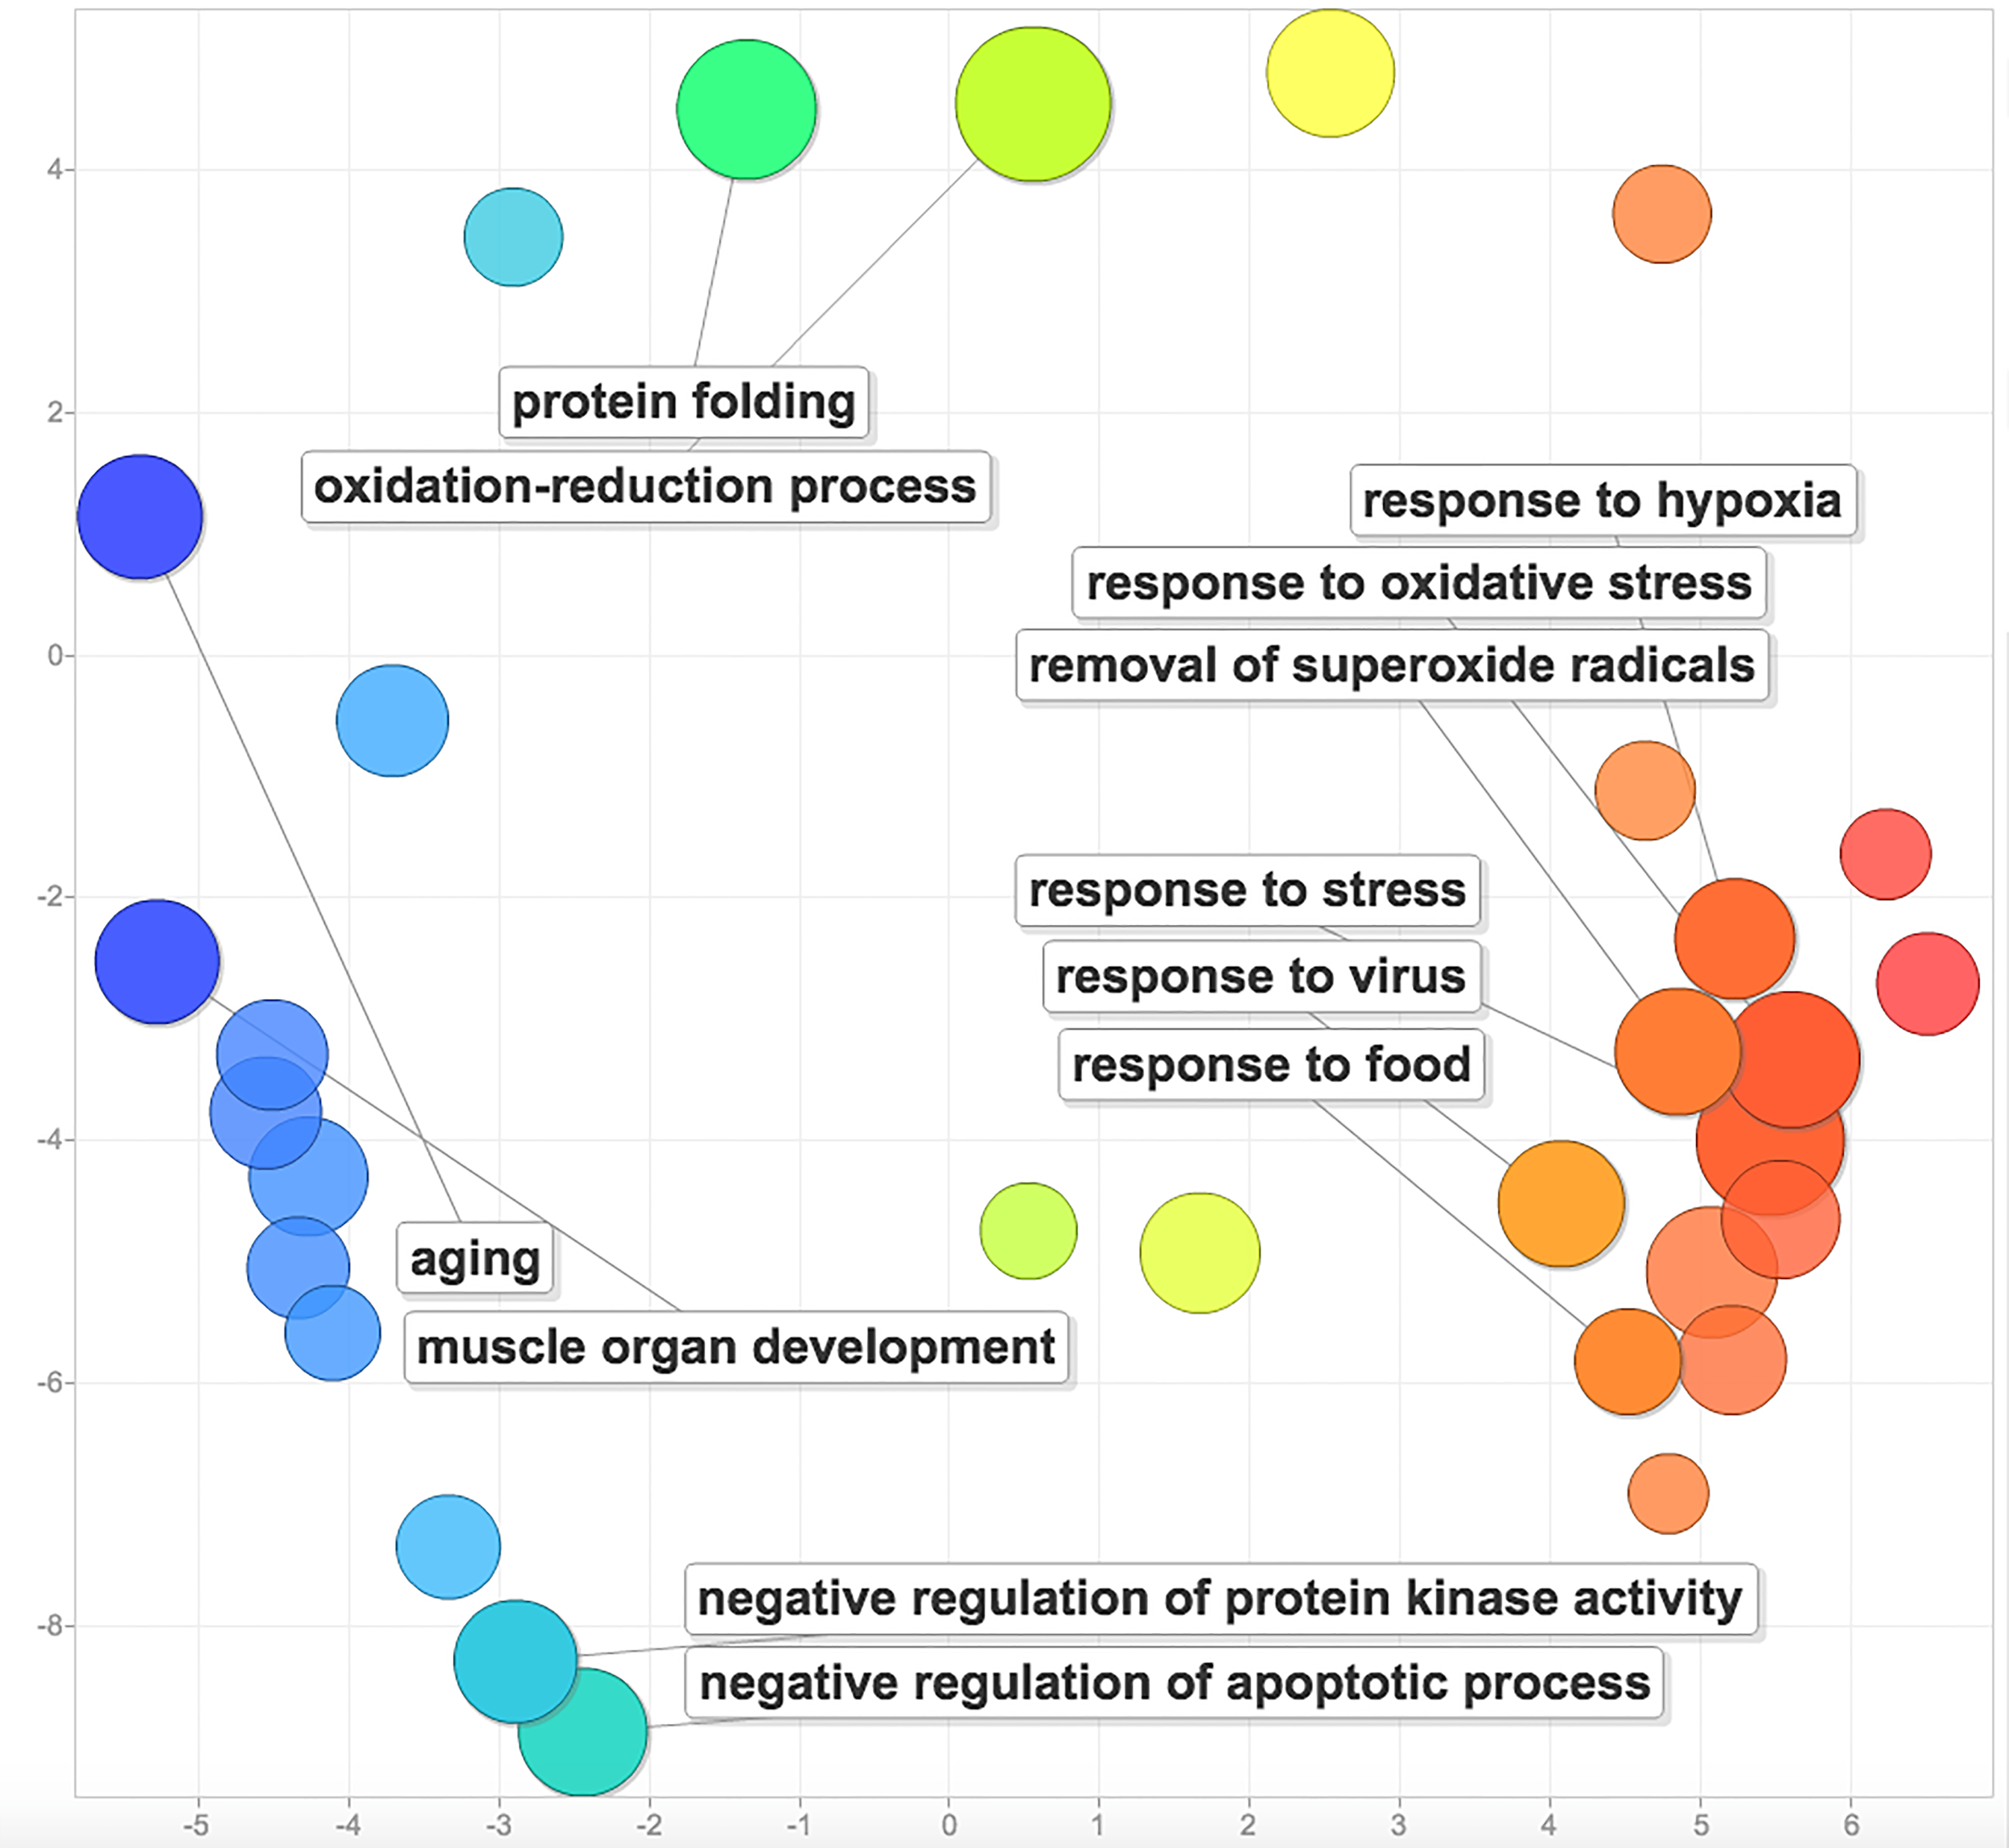
Shotgun Proteomics
10 gill samples, 1from each site and habitat type
9,047 proteins identified
273 related to environmental response
Notes:
For our shotgun proteomic discovery, we used took 10 oyster gill samples: one from each of our five locations and from bare and eelgrass patches. Using these preliminary samples, generated a proteomic resource that characterized protein expression for about 9,000 Pacific oyster proteins. Of our 9,047 proteins, 273 respond to changing environmental conditions. Some of those responses are pictured here. This plot clusters together similar protein functions (ex. general responses on the right and more specific processes on the left), and the size of the bubbles indicate how prominent these functions were in our protein set. Looking at this, we can see that there are many processes at play when Pacific oysters respond to changing environmental conditions.

Slide 8
Shotgun Proteomics
273 response proteins
37%
37%
26%
temperaturerelated
oxidative stress
hypoxia
18%
18%
heat shock
pH response
Notes:
Of the environmental response proteins we found, 37% were temperature related proteins, with 18% as specific heat shock proteins. Heat shock proteins are responsible for stabilizing other proteins so they can perform functions under high temperature conditions. These proteins also act as general stress response proteins, so if there’s anything that causes proteins to denature, chances are there are some heat shock proteins out there stabilizing them. The 26% that are hypoxia related help an oyster deal with poor oxygen conditions. And finally, 37% were related to oxidative stress, and 18% specifically-related to responding to pH differences. Seeing expression of these proteins after one month of outplant can be an early indication of changing environmental conditions that could potentially have a negative impact on Pacific oysters.

Slide 9
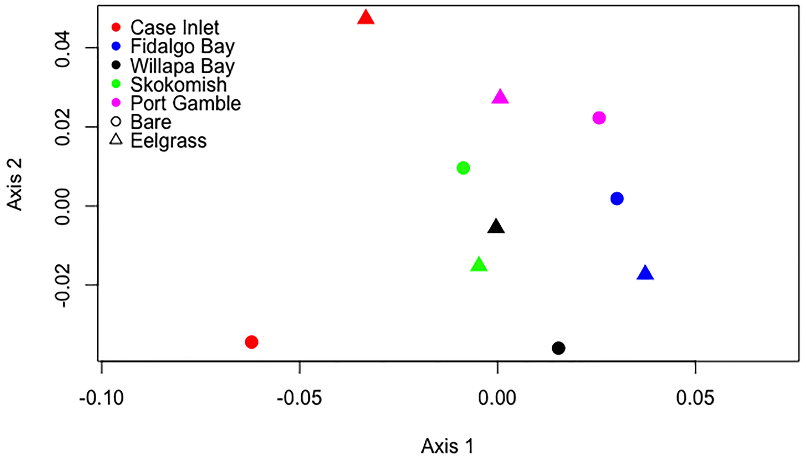
Shotgun Proteomics
10 ctenidia samples, 1from each site and habitat type
9,047 proteins identified
273 related to environmental response
Possible site effect
Notes:
When we examined how expression of those environmental response proteins varied across our sites and between our eelgrass and bare patches, we saw a slight indication of proteins being more similar at each site as opposed to between eelgrass patches. In this NMDS plot, each color represents a site, with circles representing bare patches and triangles representing eelgrass patches. You can see that the points cluster together by color, indicating a possible site effect. The next step was to examine these initial trends further using selected reaction monitoring.

Slide 10
Targeted Analysis
Function | Number of Proteins
Oxidative stress | 4
Heat shock | 1
Acid-base balance | 1
Drug resistance | 1
Fatty acid metabolism | 1
Carbohydrate metabolism | 2
Cell growth and maintenance | 5
Total | 15
Notes:
Based on data quality from our shotgun proteomics results and protein functions, we selected 15 proteins with the following functions to analyze in-depth. Aside from proteins relating to environmental conditions, we also chose proteins related to metabolism. Oysters responding to environmental stress have to choose between diverting energy resources to stress response or to growth. Having these protein targets allows us to see if there’s a shift in resources and a corresponding signature in metabolism.

Slide 11
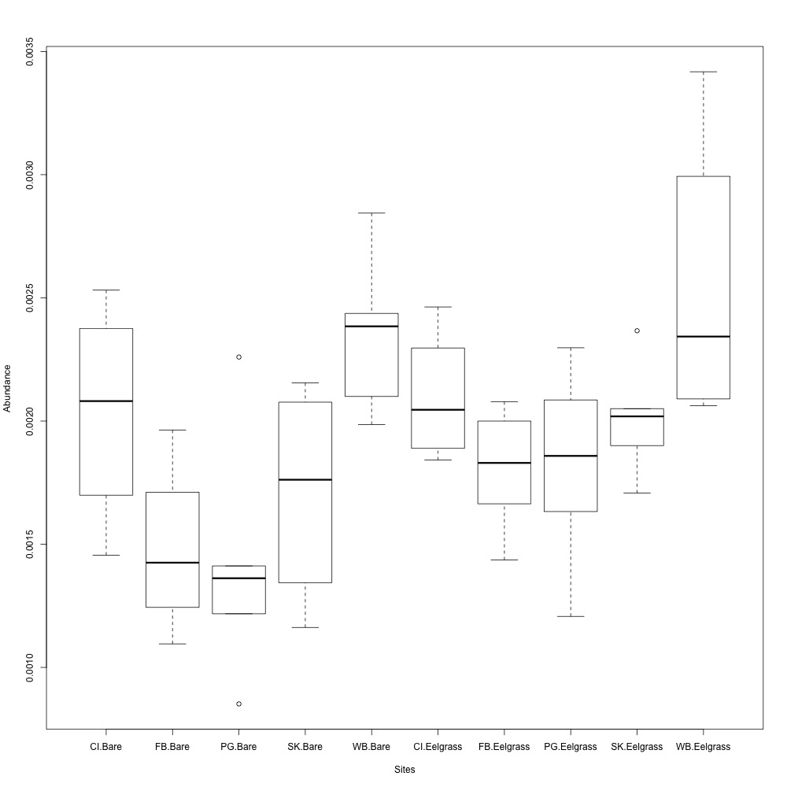
Targeted Analysis
Thioredoxin Reductase Protein Expression across Sites and Eelgrass Conditions
Notes:
Based on initial protein expression data from 50 samples (10 for each site, and split 5/5 between eelgrass and bare patches), we started to look at preliminary expression data. This boxplot describes initial normalized protein abundance for thioredoxin reductase (y axis) between sample sites and eelgrass conditions (along the x axis). thioredoxin reductase is an oxidative stress protein, helping rid the cell of reactive oxygen species before they cause damage. You can see the same pattern general pattern in protein abundance for sites both in bare patches and eelgrass patches. Willapa Bay has the highest median abundance, with Fidalgo Bay and Port Gamble Bay having the lowest median abundance. During our outplant the Skokomish River Delta had the lowest pH, while Willapa Bay had one of the highest pH. Based on our environmental data, we expected median abundance of an oxidative stress protein to be highest at our site with the lowest, most acidic pH. That’s not the case with our data. This could be because Pacific oysters at Skokomish River Delta are choosing to divert their limited energy resources away from environmental response and towards general growth and maintenance. Our next step is to not only if environmental variables like pH, DO and temperature explain any of the similarities or differences, but also compare expression of environmental response proteins with growth and maintenance proteins for any clear energy resource diversions (ex. away from environmental response and towards metabolism)

Slide 12
Why?
Early indicators of environmental change
Help select ideal grow out conditions
FB
PG
CI
SK
Notes:
After being out for only a month, our Pacific oysters already exhibit some differing median protein expression levels based on their outplant location. The proteins we’ve selected can be used as biomarkers to monitor water conditions at potential grow-out locations. Protein expression is sensitive to environmental conditions, so it can serve as an early indicator for how ideal conditions are for Pacific oyster aquaculture. Just bringing you back to the Feely et al. 2010 image I showed you earlier, I overlayed the rough location of our four Puget Sound sample sites. You can see that conditions at our sites are different, so understanding how local environmental variables affect Pacific oysters is crucial for production at these sites.

Slide 13
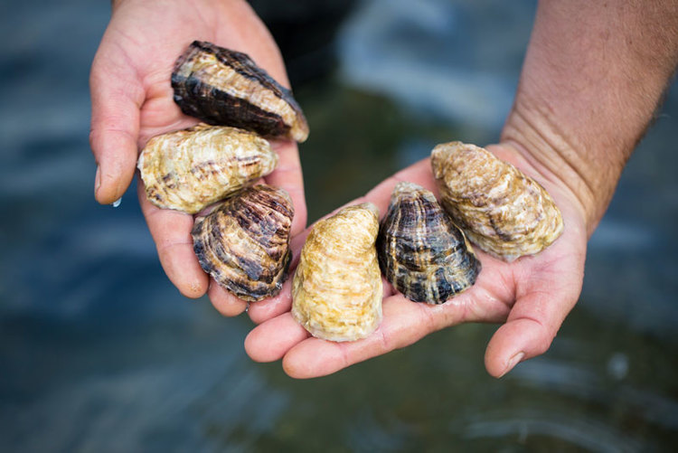
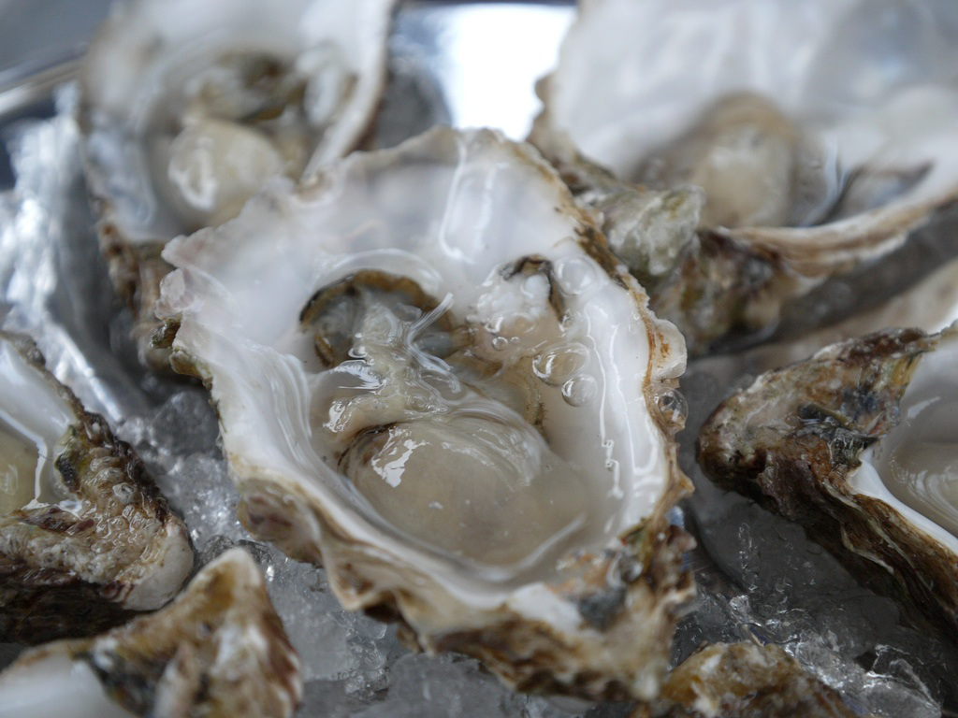
Conclusion
Created proteomic resource
Characterized potential biomarkers
Location-specific environment → protein expression
Photo from Capital Oysters
Photo from World Media Foundation
Notes:
By outplanting sibling Pacific oysters at five different locations in and around Puget Sound, we evaluated the effect of location-specific environmental variables on protein expression. The baseline proteomic resource we created characterizes expression of 9,000 proteins. Out of 200 proteins involved in the organism's response to environmental change, we selected 15 potential biomarkers to analyze further. Our preliminary results show that there are some differences in median protein expression by site, demonstrating that this proteomic technique can be used as an early indication of how suited a certain location is for Pacific oyster aquaculture. Our next steps are to dive further into our targeted proteomics data and understand how environmental variables like pH, DO and temperature affect protein expression at our sites. Our proteomic resource can even be used to understand how temporal changes affect conditions for aquaculture in the sound.

Slide 14
Thank You!
http://bit.ly/project-oyster-oa
yaaminiv@uw.edu
@YaaminiV

Slide 15

Experimental Overview
150 oysters
outplant to 5 sites
3 replicates
eelgrass vs. no eelgrass
Water chemistry data (temperature, dissolved oxygen)
Protein extraction

